Slide 1
Why be an entrepreneur?
Technopreneurship
SoCIT – Asia Pacific College

Slide 2

The Filipino employee is in distress!
Believe it or not!
Haay…. Napakahirap ng buhay!

Slide 3

Bagay-bagay na bumabagabag sa ating isipan?
Suliraning walang kalutasan?
Pera? Pera? Pera? Pera?

Slide 4
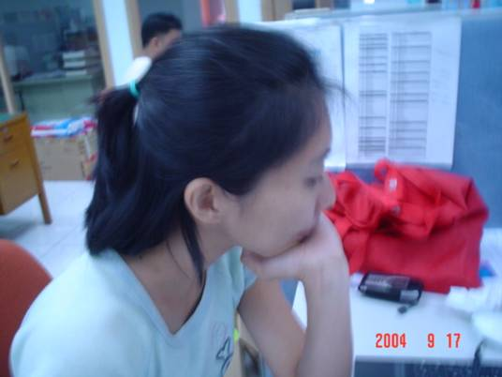
Gusto kong bumili ng bahay… Kaya lang wala akong pera… Saan kaya puwedeng umutang????

Slide 5
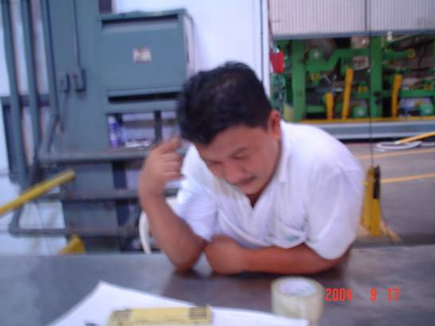
Saan kaya puwedeng ilagay itong pera ko? Sa Banko? Sa Negosyo? Sa Investment House? Bumili kaya ako ng kotse???

Slide 6
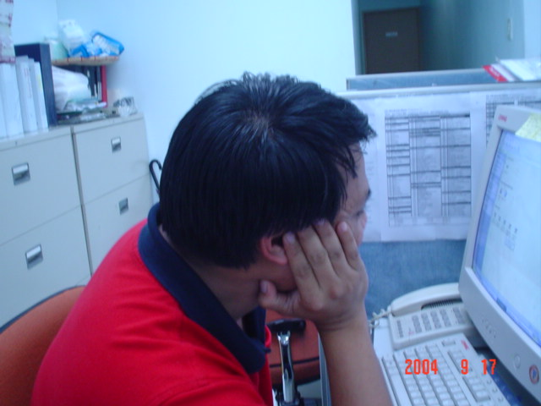
Trabaho ako ng trabaho… Pero laging kapos ang suweldo ko…Ano ang gagawin ko para madagdagan pa ang pera ko???

Slide 7
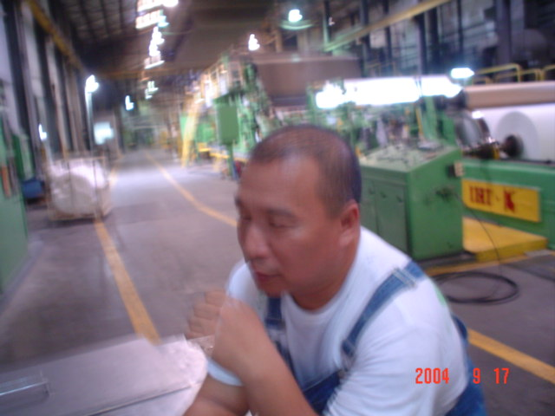
Kung sakaling mawalan ako ng trabaho, paano na ang pamilya ko? Ano ang gagawin ko sa perang matatanggap ko???

Slide 8
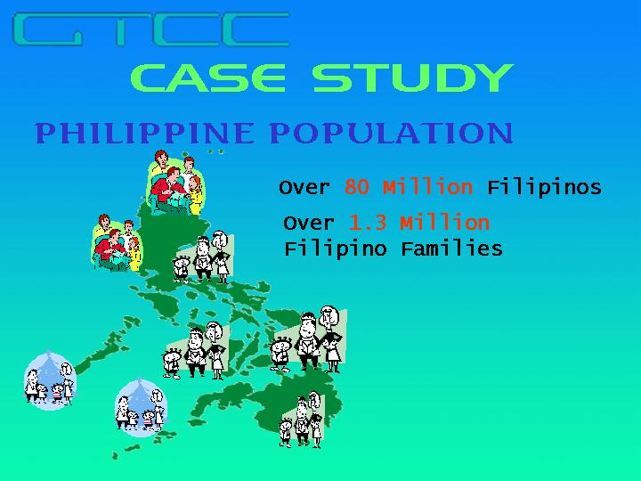
The HARD FACTS
100 Million
1.8 Million

Slide 9
The Hard Facts
Most Filipinos earn below Minimum Wage!
Scenario A
Gross P 250 .00 (Metro Manila)
- less 25% (deductions: tax, SSS, PhilHealth, etc.)
= Net P 187.50 (Metro Manila)
Scenario B
Gross P 237 .00
- less 25% deductions
= Net P177.75
Notes:
There are 64.000 Cooperatives
50% are operating

Slide 10

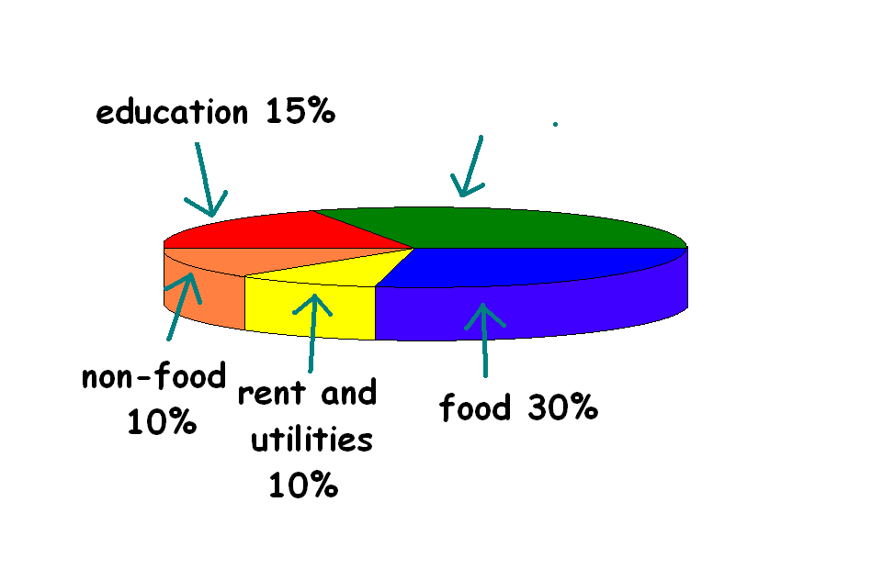
Where the Income Goes

Slide 11
Your Standard of Living
Prices
PESO VALUE
LUXURY
Family
COMFORT
COMFORT
INCOME
BASIC NEEDS
POVERTY

Slide 12
The BIG QUESTION:
HOW WILL YOU STRETCH YOUR BUDGET?
LUXURY
Family
Family
COMFORT
Family
COMFORT
COMFORT
INCOME
INCOME
BASIC NEEDS
BASIC NEEDS
INCOME
POVERTY

Slide 13
Oh No! Another PROBLEM!
Inability to SAVE for the FUTURE!
Expenses
Income
Income
LOST INCOME
LOST INCOME
Sudden Unemployment
Business Failure
Death and Sickness
RETIREMENT
Age
65
45
50
55
65
21
60
65
Notes:
Income can be lost
If we draw our income, it looks something like this going up, up and steady.
But during retirement, it goes down drastically like this.
Sometimes, we don’t even get to retirement
Income is lost through sudden unemployment, business failure, sickness or death.

Slide 14
Are you prepared for the FUTURE?
YES
NO
Do you want this to happen to your family?
LUXURY
Family
COMFORT
COMFORT
COMFORT
Family
INCOME
BASIC NEEDS
BASIC NEEDS
BASIC NEEDS
Family
POVERTY
POVERTY

Slide 15
What are the options?
EMPLOYMENT
BUSINESS
SELF-EMPLOYED
INVESTMENT

Slide 16
Introduction to Entrepreneurship
Nature and Importance of Entrepreneurs

Slide 17
Definition of Entrepreneurship Today
A kind of behavior that includes:
Initiative taking
The organizing and reorganizing of social and economic mechanisms to turn resources and situations to practical account
The acceptance of risk or failure
The process of creating incremental wealth

Slide 22
Definition of Entrepreneurship Today
Entrepreneurship – the process of
creating something new with value
by devoting the necessary time and effort,
assuming the accompanying financial, psychic, and social risks, and
receiving the resulting rewards and personal satisfaction and independence.

Slide 23
48K

Slide 24
Entrepreneurs vs. Inventors
Inventor – an individual who creates something for the first time, is a highly driven individual motivated by his or her own work and personal ideas.
An entrepreneur falls in love with the new venture and will do almost anything to ensure its survival and growth

Slide 25
The Entrepreneurial Process
Four distinct phases:
Identification and evaluation of the opportunity
Development of the business plan
Determination of the required resources
Management of the resulting enterprise

Slide 26
The Entrepreneurial Process
Identify and evaluate the opportunity
Opportunity assessment
Creation and length of opportunity
Real and perceived value of opportunity
Risk and returns of opportunity
Opportunity vs. personal skills and goals
Competitive environment

Slide 27
The Entrepreneurial Process
Development of the business plan
Title page
Table of contents
Executive Summary
Major section
Appendixes (Exhibits)
Description of business
Description of industry
Technology plan
Marketing plan
Financial plan
Production Plan
Organizational Plan
Operation Plan
Summary

Slide 28
The Entrepreneurial Process
Determination of the required resources
Determine resources needed
Determine existing resources
Identify resource gaps and available suppliers
Develop access to needed resources

Slide 29
The Entrepreneurial Process
Management of the resulting enterprise
Develop management style
Understand key variables for success
Identify problems and potential problems
Implement control systems
Develop growth strategy

